Slide 1
SECURE DATA HIDING IN IMAGES USING STEGANOGRAPHY
CAPSTONE PROJECT
Student Name : Tadapaneni Charan Sai
College Name & Department :Raghu Engineering College (CYBER SECURITY)

Slide 2
OUTLINE
Problem Statement
Technology used
Wow factor
End users
Result
Conclusion
Git-hub Link
Future scope

Slide 3
Problem Statement
The Python-based steganography system leverages OpenCV to embed covert messages within image pixel matrices, ensuring discreet data concealment.
During encryption, the script modulates pixel values to encode the message, safeguarding access with a passcode that is externally maintained.
Decryption reverses this process, extracting the concealed data only upon validation of the correct passcode, reinforcing security and controlled information retrieval.

Slide 4
Technology used
Programming Language:
Python: The implementation is entirely written in Python, taking advantage of its readability and extensive library support.
Libraries and Modules:
OpenCV (cv2): Facilitates image processing, including reading, modifying, and saving images.
OS: Enables interaction with the operating system, such as file handling and command execution.
string: Imported but not utilized in the code; generally, provides string operations and constants.
Platforms:
Operating System: Primarily designed for Windows, as indicated by file path structures (e.g., C:\Users\Charan\...).
Python Environment: Requires a Python 3.~~ interpreter for compatibility with modern libraries.
Technologies & Concepts Applied:
Steganography: Concealing secret data within image pixel values.
File Handling: Managing file input/output, including password protection (though security enhancements are recommended).
Basic Encryption Mechanism: Encoding message characters within an image’s pixel values.
Image Format Support:
Compatible with image formats supported by OpenCV, such as BMP, PNG, JPEG, TIFF and others.

Slide 5
Wow factors
Low-Level Pixel Editing: Utilizes OpenCV to directly alter RGB values, allowing seamless integration of hidden messages within image data.
Efficient Multi-Channel Encoding: Spreads message bits across different color channels (Red, Green, and Blue) to maintain image integrity and reduce detectability.
Secure Access Control: Implements a password requirement for decryption, ensuring that only authorized users can retrieve the embedded message.
Persistent Password Management: Automatically stores the passcode in a separate text file, enabling future decryption without requiring users to remember or re-enter it.
Minimalist Steganography Approach: Embeds secret messages in pixel data without relying on complex encryption techniques, keeping the process simple yet effective.
Intuitive User Input System: Uses console-based prompts for message and password entry, making it easy to use even for individuals without advanced technical knowledge.

Slide 6
End users
Finance Sectors.
Military Operations.
Data and Cyber protection.
Personal/Corporate Security.
Blockchain & Cryptocurrency.
Artificial Intelligence (AI) & Machine Learning (ML).

Slide 7
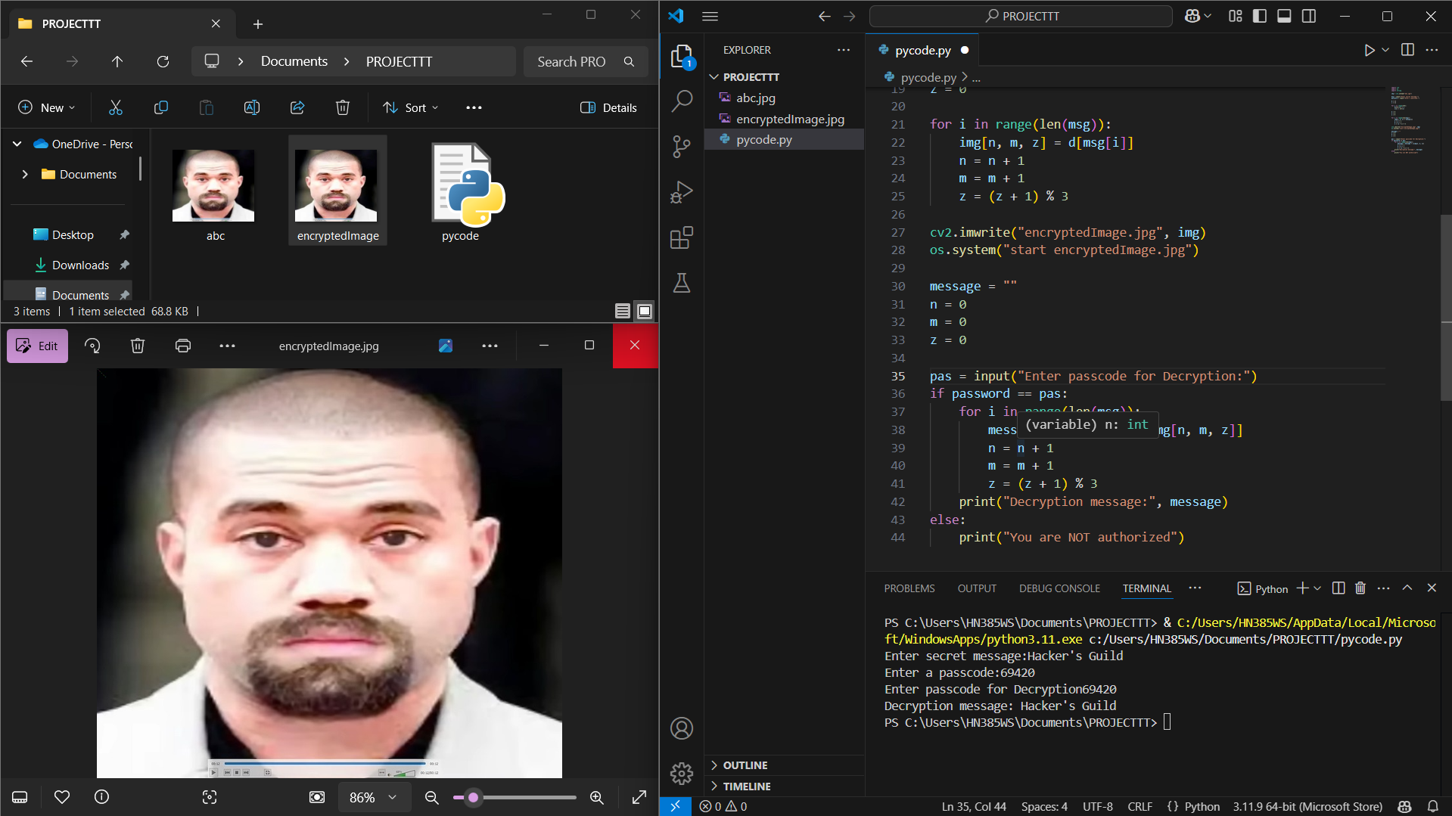
Results

Slide 8
Conclusion
This project presents a fundamental yet robust implementation of image-based steganography using Python and OpenCV. By embedding confidential messages within the pixel values of an image and reinforcing access control through password protection, the system establishes a foundational mechanism for data security and user authentication. It effectively demonstrates how steganography can be leveraged for secure communication, making it a valuable tool for educational applications and an entry point into cybersecurity practices.

Slide 9
GitHub Link
https://github.com/Charanuu-git/CS-Project-2.0.git

Slide 10
Future scope :
Advanced Cryptographic Integration
2. Enhanced Graphical User Interface (GUI) Architecture
3. Extensive Multi-Format File Support
4. Robust Secure Password Management
5. Comprehensive Mobile Application Expansion
6. Seamless Cloud-Based Infrastructure Integration
7. Sophisticated Error Handling and Performance Enhancement

Slide 11
THANK YOU

